Slide 1


Slide 2
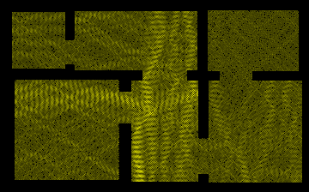
radiation
Abhinav Choudhary
Souvik Dinda
Zixiao Li
Hariharan Sundaram

Slide 3
Presentation Flow
Zixiao Li
Algorithm
Hariharan Sundaram
Java program – Calculation
Souvik Dinda
Java – Front-End, Design, and Issues
Abhinav Choudhary
Implementation issues, Multi-Threading, Future scope, Demo

Slide 4

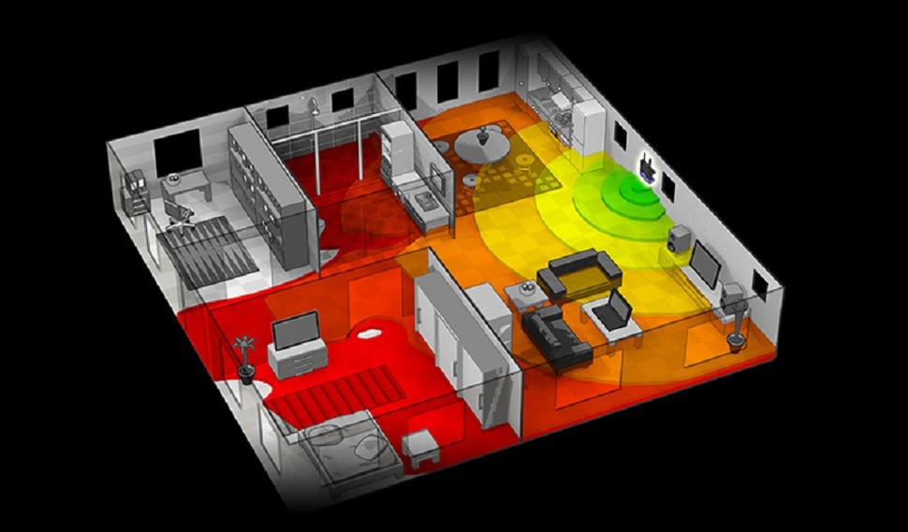
Inspiration
Why not simulate the Wi-Fi strength?
Signal in some corner of your house is weak?

Slide 5
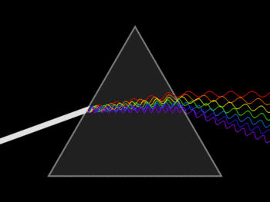
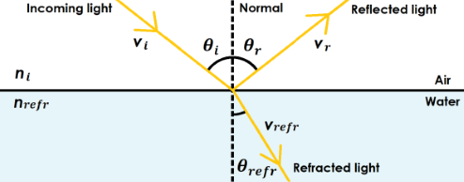
Physical Algorithm-how electric-magnetic wave transmit?
Before Maxwell
1. light goes in a straight line in same material
2.when light goes into the boundary of another material, it will be deflected and refracted
n: refractive index
Usually between 1~5

Slide 6
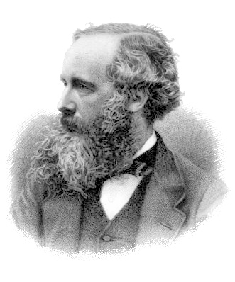
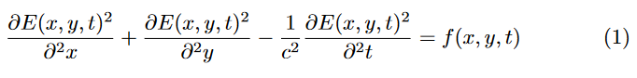
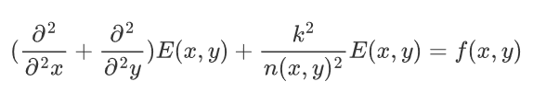
After maxwell
Helmholtz equation(time dependent)
Helmholtz equation(time independent)
Saved us from a lot of work!
Light velocity is too fast so it goes to equilibrium state before human can notice
Why only time independent?

Slide 7
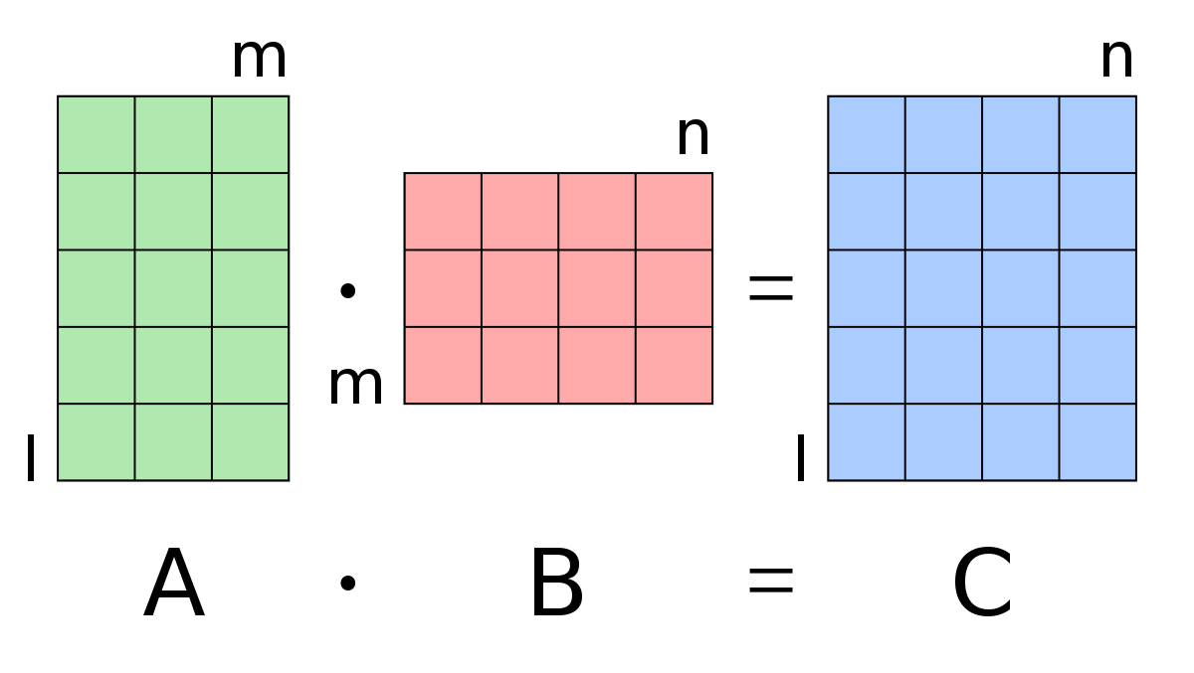
How to solve Helmholtz equation?
A class approach:
Turn a differential equation into a matrix operation

Slide 8
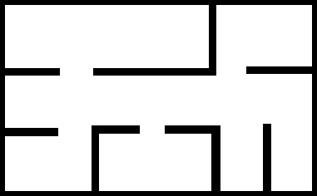
A png file of floor plan with only black pixel and white pixel
381*236 pixels picture
Will generate a 381*236 matrix

Slide 9
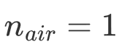
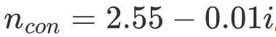
What it means?
Source distribution
Refractive index
In maxwell theory, n is a complex number!

Slide 10

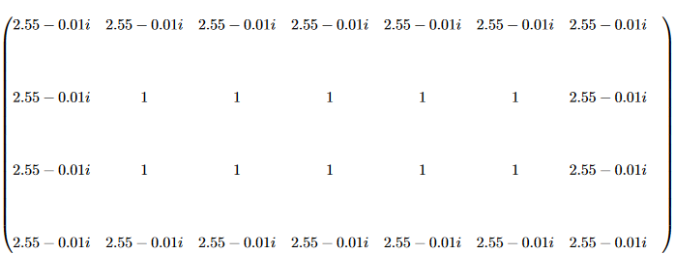
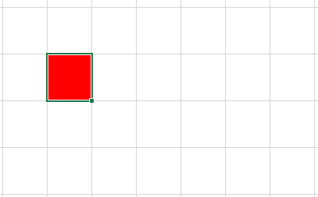
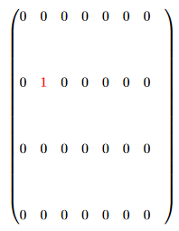

The refractive index matrix
The Wi-Fi source matrix​

Slide 11
What we need to do is we know A and C we need to get B
A problem that computer is not good at
known
unknown
known

Slide 12
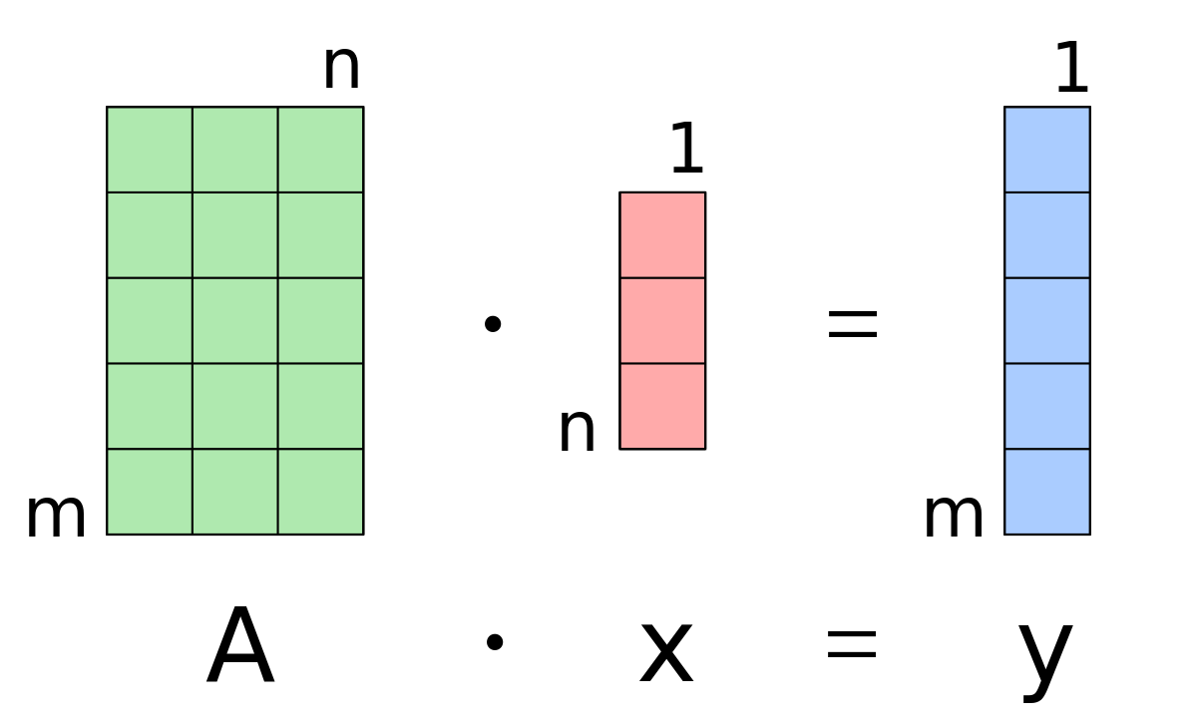
Change a matrix-matrix multiply into a matrix-vector multiply
A problem that computers are very good at!
——solve linear system
known
unknown
known

Slide 13
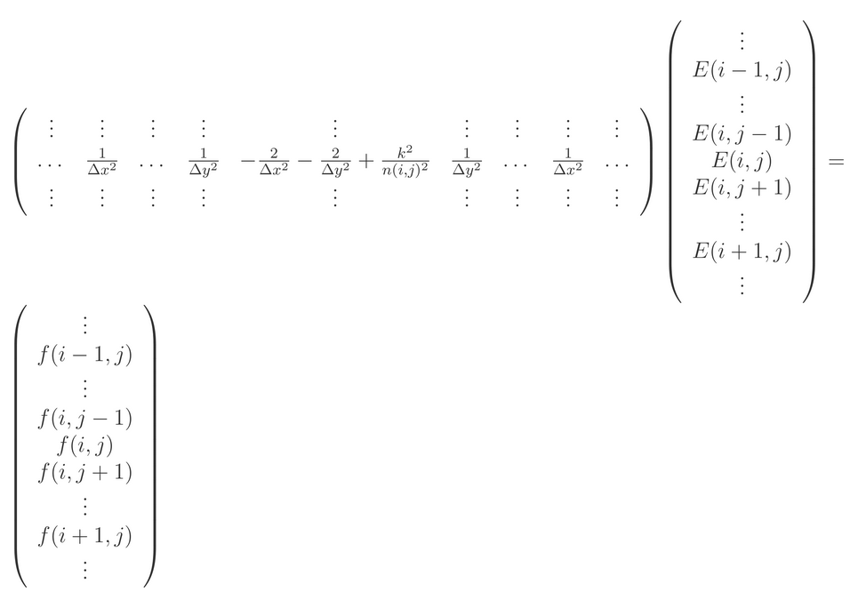
After a very complicated but exciting algorithm
381*236=89916
We turn a 381*236 matrix calculation into a 89,916*89,916 matrix calculation
The price of turning matrix into vector!

Slide 14
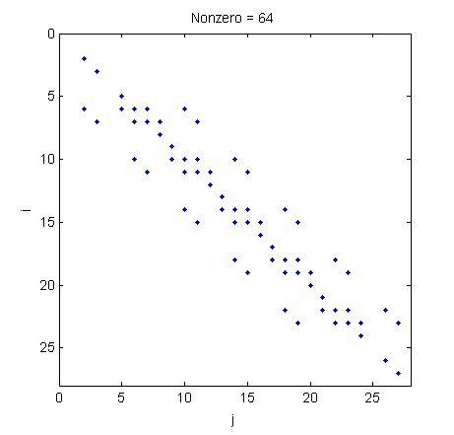


The matrix is too big for computer to solve directly
But clever mathematician invented a sparse matrix algorithm
Only 0.00625% of our matrix has no zero value
*
=
But some of the elements are complex number

Slide 15
Major Computation Requirement
A Java Library with the following capabilities
Contains Data Structure to store a Sparse Complex Matrix
Solve a linear equation of Sparse Complex Matrices

Slide 16
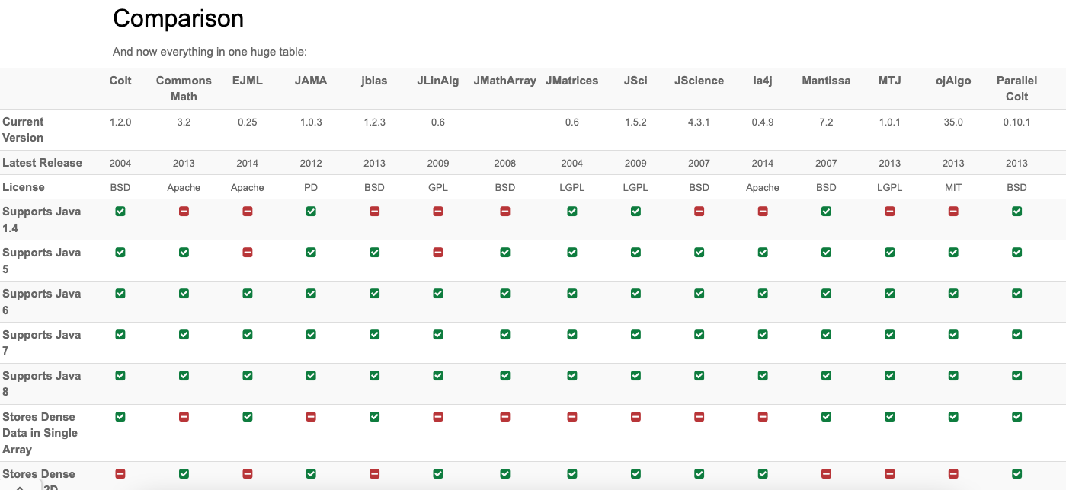

Slide 17
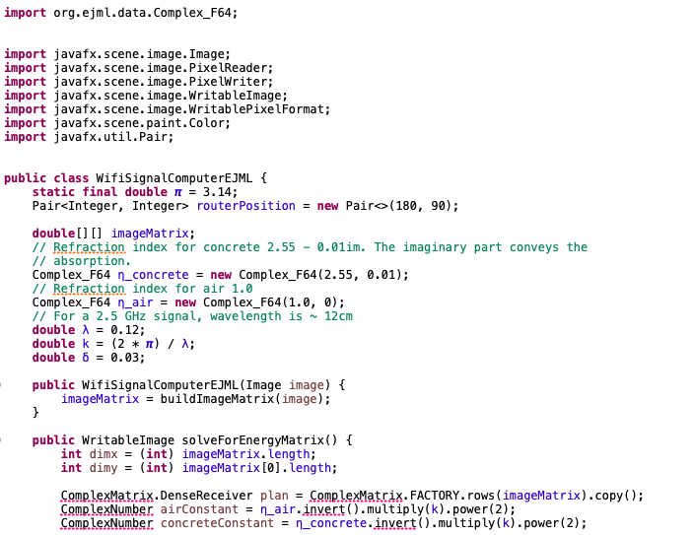
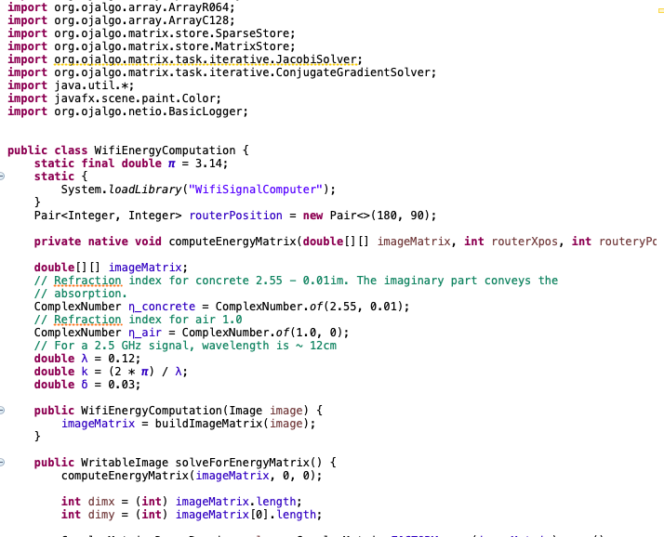
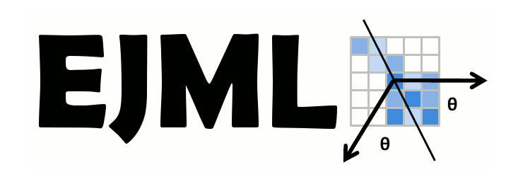


Slide 18
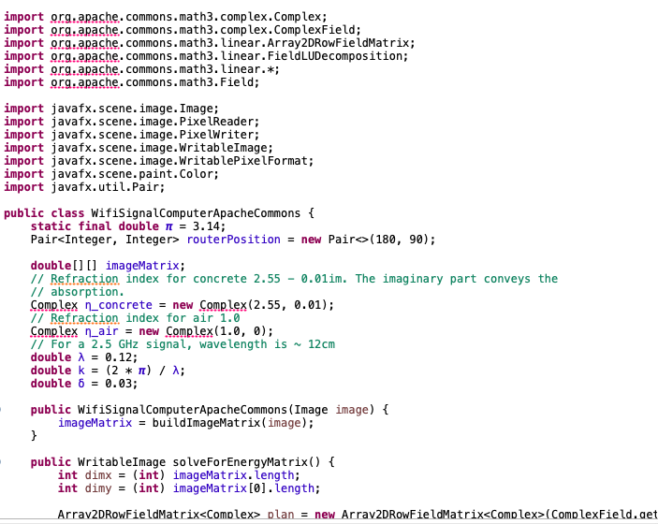






Slide 19


Interface with other Languages

Slide 20


Eigen is a C++ template library for linear algebra: matrices, vectors, numerical solvers, and related algorithms.

Slide 21
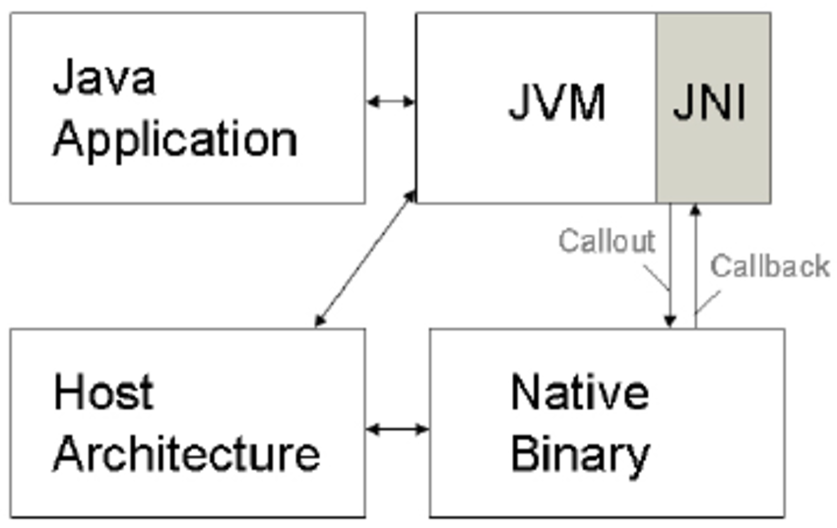
Java Native Interface(JNI)

Slide 22
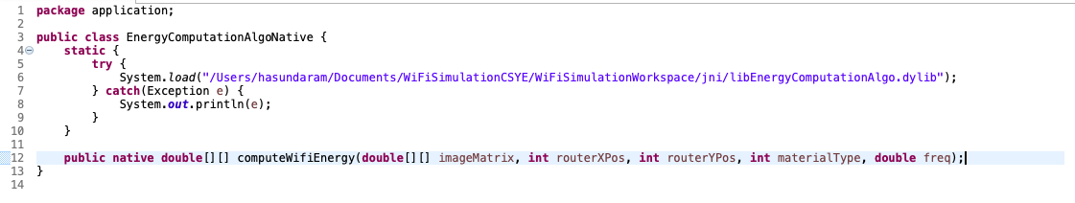
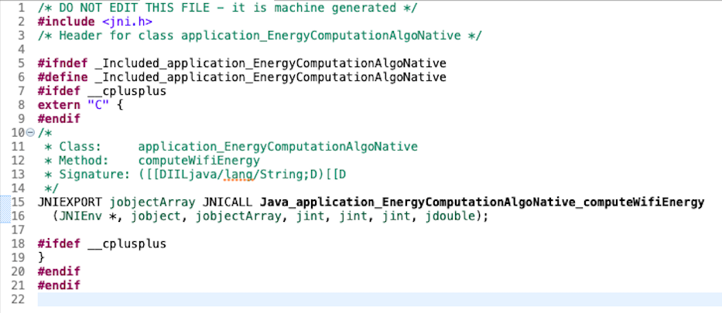
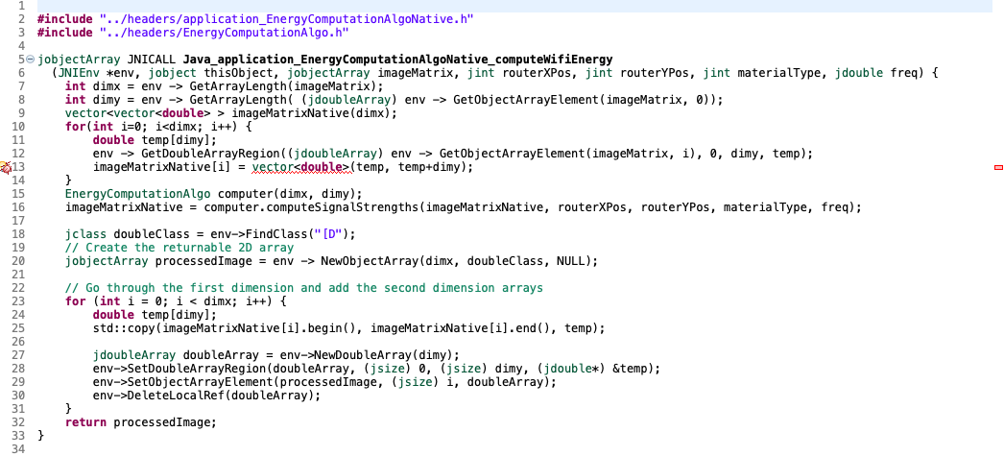

Slide 23
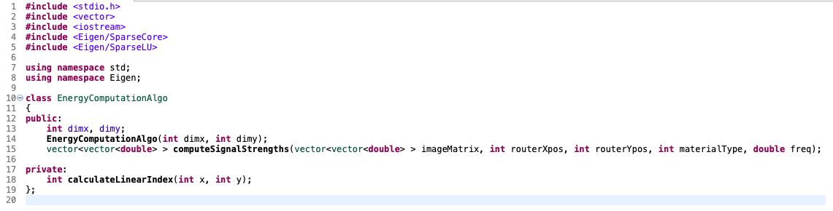
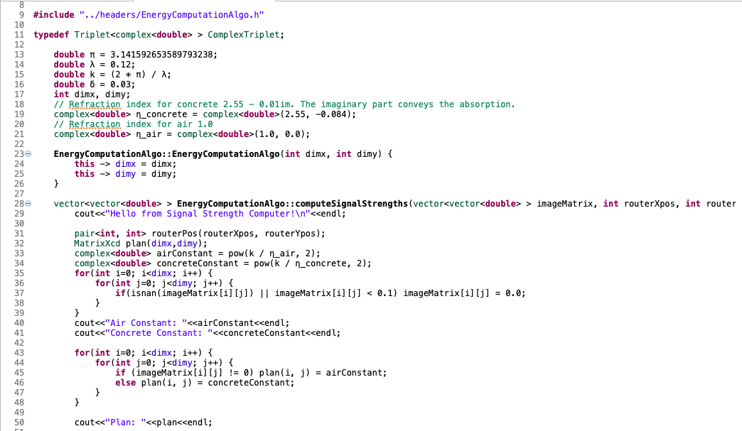
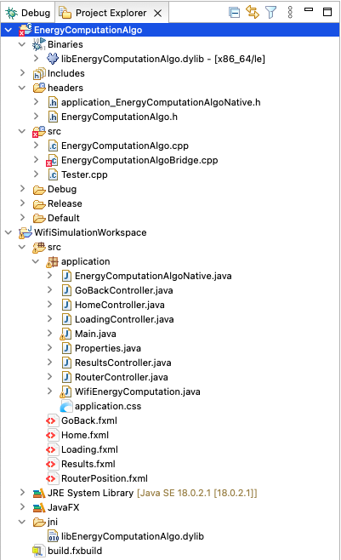

Slide 24
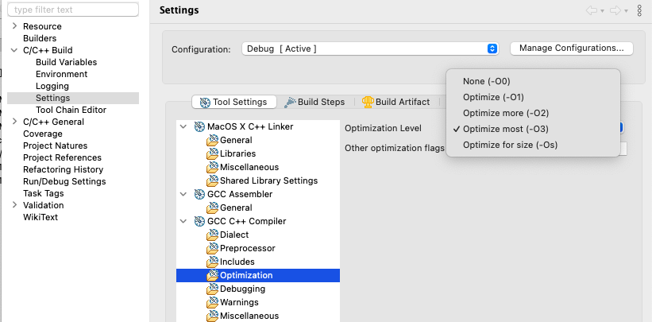

Slide 25
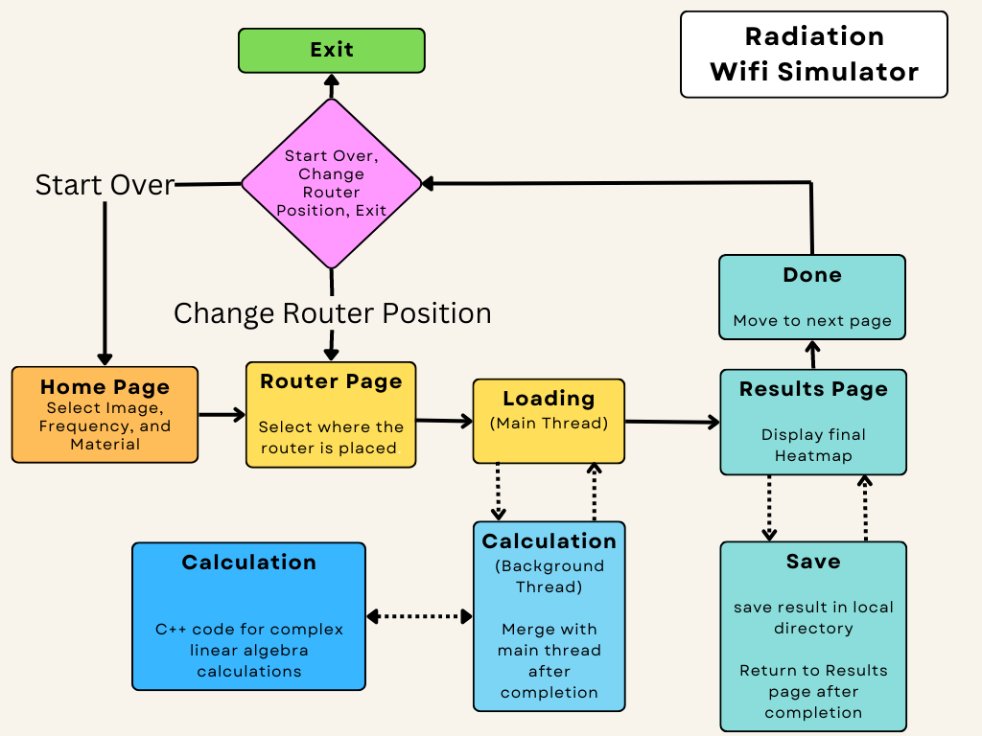
Program Flow

Slide 26
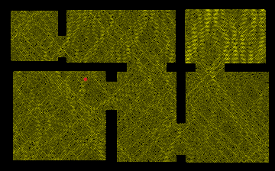
DEMO

Slide 27
Challenges Faced while developing UI

Slide 28
Challenges
Properties needed throughout program
Getting router position

Slide 29
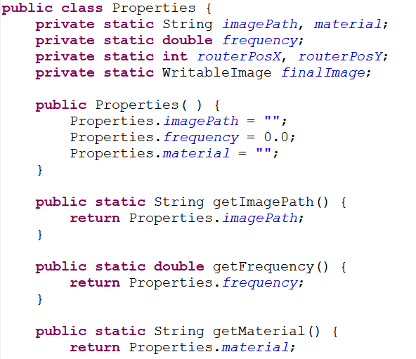
Using static variables

Slide 30
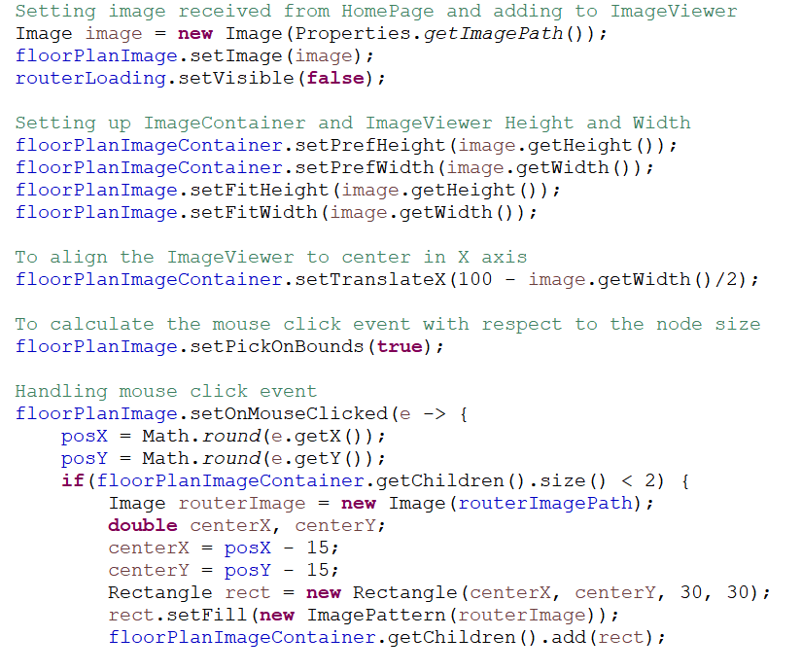
Getting Router Position -> Using Pane -> ImageViwer -> Image

Slide 31
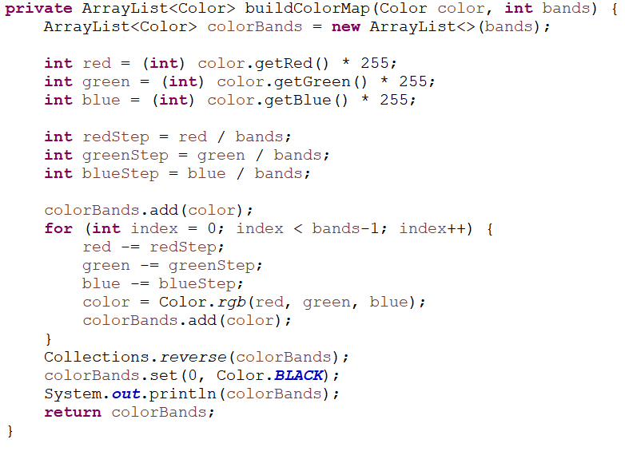
Developing HeatMap

Slide 32
Concepts Covered
Class Definitions
Interface
Inheritance
Collections
Threading
Java Native Interface
JavaFX
C++

Slide 33
Tools Used
GitHub Repository
Jira (Task Management)
Eclipse
Scene Builder
Microsoft Teams
Microsoft PowerPoint, Word (Documentation)

Slide 34
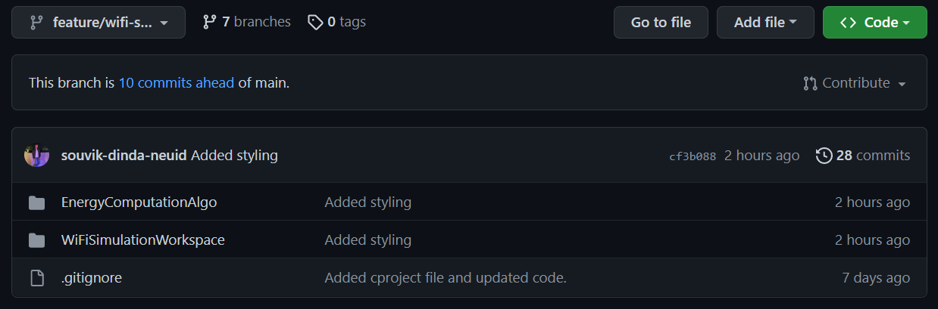
Repository

Slide 35
Tools Used
GitHub Repository
Jira (Task Management)
Eclipse
Scene Builder
Microsoft Teams
Microsoft PowerPoint, Word (Documentation)

Slide 36
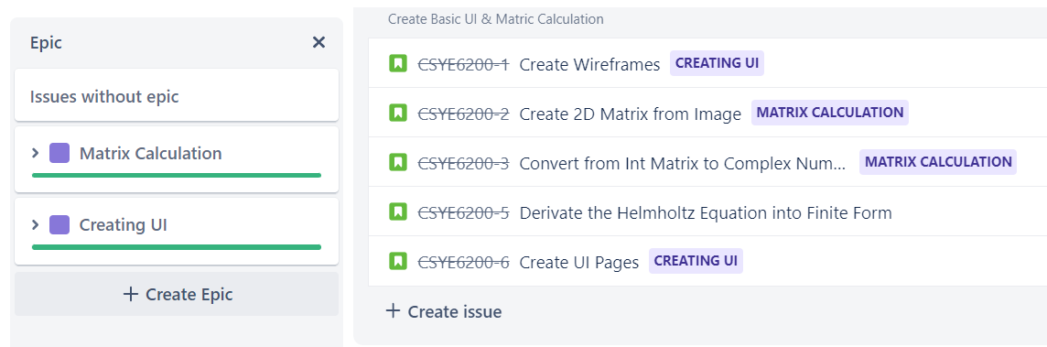
Task Management

Slide 37
Tools Used
GitHub Repository
Jira (Task Management)
Eclipse
Scene Builder
Microsoft Teams
Microsoft PowerPoint, Word (Documentation)

Slide 38
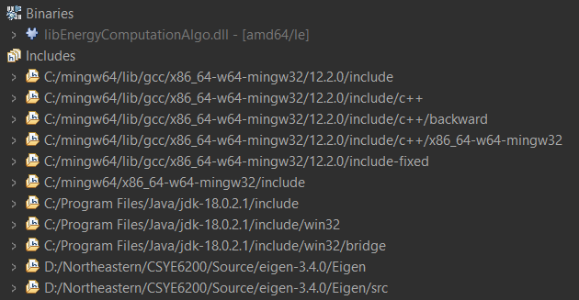
Implementation Issues between Mac and Windows
C++ codes were initially written in Mac. Took almost a day just to transition the code to Windows. For dynamic library, Mac generates .dylib whereas Windows generates .dll.
Were able to build the C++ code but found out that the compiler had built a 32 bit file which was incompatible with 64 bit java program.
Finally, was able to find MingW GCC compiler for Windows which is capable of generating results in both 32 and 64 bit.

Slide 39
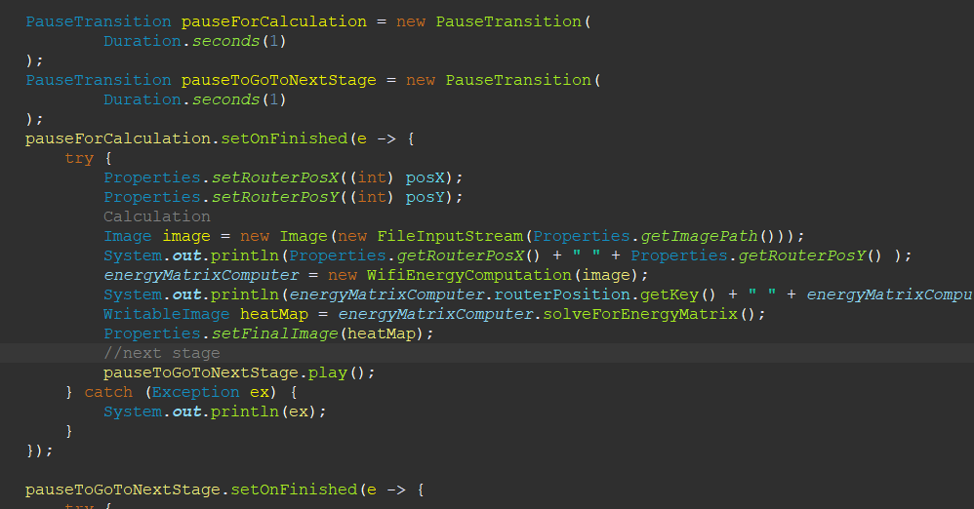
Front-End Issues with Calculations
When the calculation and frontend were on the same thread, the program would start calculations and after completion, jump straight to the results page without updating then frontend for loading indication, leaving the user clueless whether something is happening or not.
Tried to add PauseTransition in the program to pause before starting the calculations and give time to update the frontend, but as soon as the calculation starts, the frontend freezes and after calculation completion program goes to next screen.
Solution? Multi-Threading

Slide 40
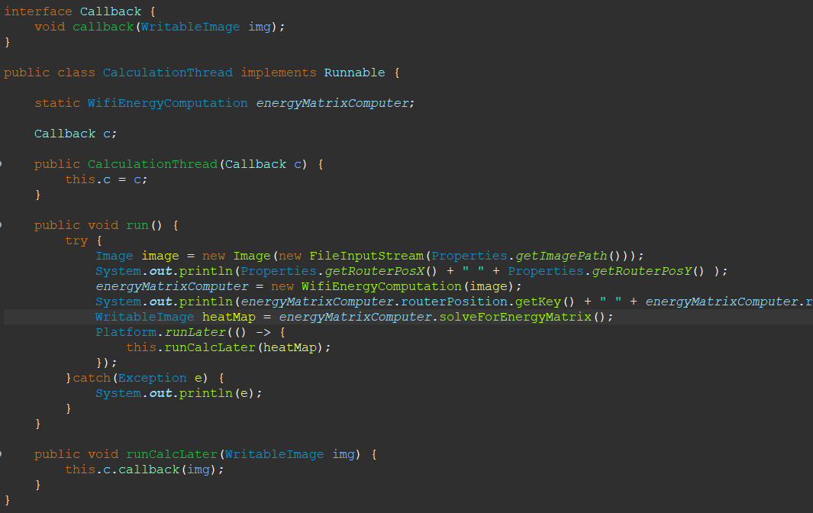
Multi-Threading
After selecting the router location and clicking on continue, the main thread updates the frontend (disables continue button and make loading visible) and a new background thread is generated, all the calculations take place in the background thread leaving the main thread free to run the loader. After the calculations are completed, the results are called back and background thread is merged with the main thread, after which the main thread proceeds further to the results page, displaying the final heatmap image.

Slide 41
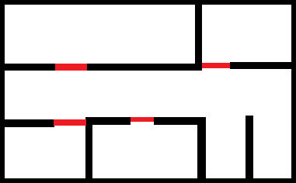
Future Scope
Add support for 5Ghz frequency band
Add new materials (like glass, metal, brick, etc)
Add support for multiple wall materials at the same time
Add option to create custom floor plans within the app
Add different colors to signify different strengths of the signal
Suggest the most optimal location for the router

Slide 42



